Slide 1

Chapter 24
Performing CSS Transitions and Animations

Slide 2
Learning Objectives
How to use CSS transitions to specify an HTML element’s ending state, as defined by CSS property values
How to trigger a CSS transition by changing the value of one of the properties the transition uses so that the browser will apply the transition
How to create a CSS animation using a collection of CSS transitions

Slide 3
Starting with transitions
To create a CSS transition, specify ending state property values for an HTML element, such as color, opacity, or location. When you change one of the specified property values, you trigger the browser’s application of the transition.

Slide 4

Changing image opacity
<!DOCTYPE html> <html> <head> <style> img { -moz-transition: opacity 5s; -ms-transition: opacity 5s; -o-transistion: opacity 5s; -webkit-transition: opacity 5s; transition: opacity 5s; } </style> <script> function ShowImage() { document.getElementById("wine").style.opacity = 1; } </script> </head> <body> <img id="wine" style="opacity:0" src="http://www.websitedevelopmentbook.com/chapter23/wine.jpg"><br/> <button onclick="ShowImage()">Click Here</button> </body> </html>

Slide 5
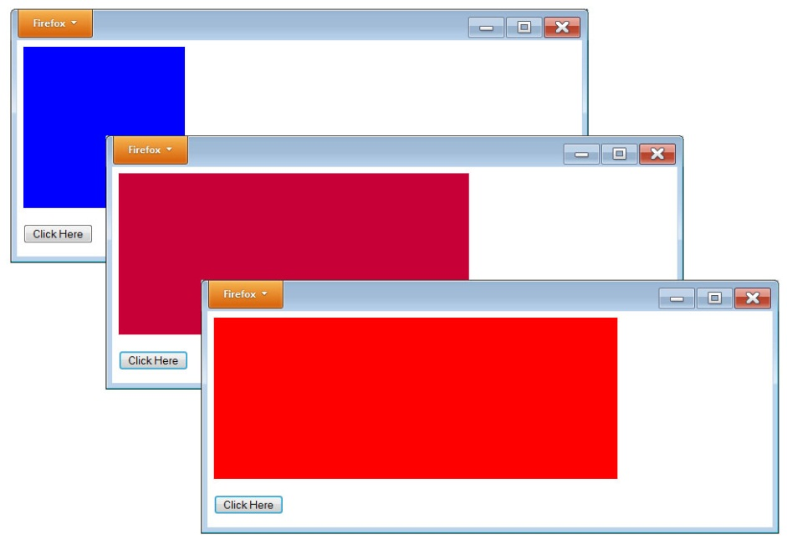
Extending a box
<!DOCTYPE html> <html> <head> <style> div { -moz-transition: width 5s, background-color 5s; -ms-transition: width 5s, background-color 5s; -o-transition: width 5s, background-color 5s; -webkit-transition width 5s, background-color 5s;
transition: width 5s, background-color 5s; } </style> <script> function SlideBox() { document.getElementById('box').style.width = '500px'; document.getElementById('box').style.backgroundColor = '#FF0000'; } </script> </head> <body> <div id="box" style="background-color:blue; position:relative; width:200px; height:200px;"> </div><br/> <button onclick="SlideBox();">Click Here</button> </body> </html>

Slide 6
Using a timer to slide a box
<!DOCTYPE html> <html> <head> <style> div { -moz-transition: width 5s, background-color 5s; -ms-transition: width 5s, background-color 5s; -o-transition: width 5s, background-color 5s; -webkit-transition width 5s, background-color 5s; transition: width 5s, background-color 5s; } </style> <script> var direction = "right"; function CloseBox() { document.getElementById('box').style.width = '200px'; document.getElementById('box').style.backgroundColor = '#0000FF'; setTimeout(function () { SlideBox(); }, 6000); } function SlideBox() { document.getElementById('box').style.width = '500px'; document.getElementById('box').style.backgroundColor = '#FF0000'; setTimeout(function () { CloseBox(); }, 6000); } </script> </head> <body> <div id="box" style="background-color:blue; position:relative; width:200px; height:200px;"> </div><br/> <button onclick="SlideBox();">Click Here</button> </body> </html>

Slide 7
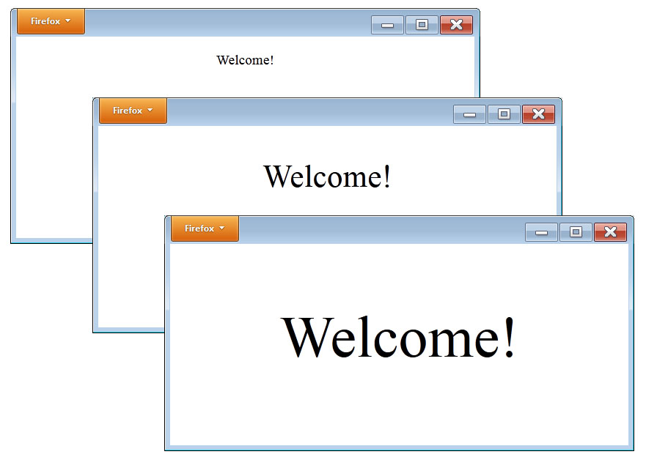
Scaling a welcome message
<!DOCTYPE html> <html> <head> <style> p { -moz-transition: font-size 8s; -ms-transition: font-size 8s; -o-transition: font-size 8s; -webkit-transition font-size 8s; transition: font-size 8s; } </style> <script> function GrowFont() { document.getElementById('welcome').style.fontSize = '500%';
} </script> </head> <body onload="GrowFont()"> <div> <p id="welcome" style="text-align:center;">Welcome!</p> </div> </body> </html>

Slide 8
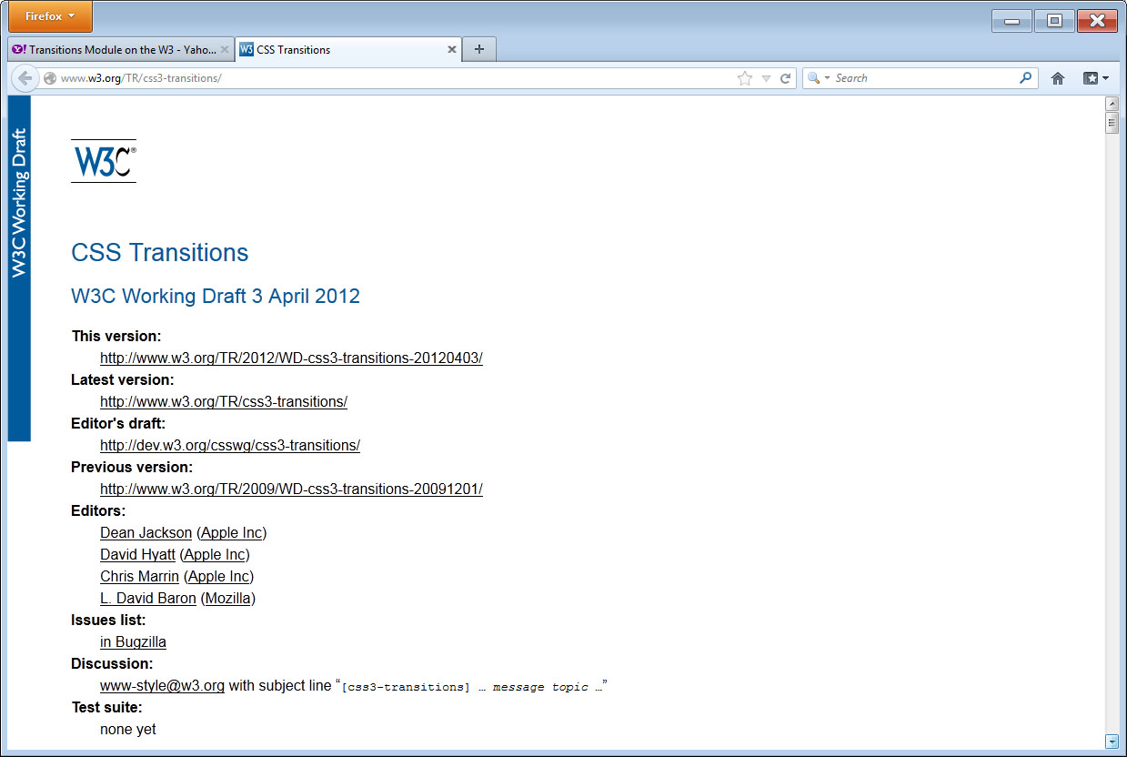
Real world: w3c Css transitions

Slide 9
summary
Throughout this book, you have performed text- and graphics-based animations using JavaScript, JQuery, and the HTML 5 canvas.
In this chapter, you learned how to use CSS transitions to specify an HTML element’s ending properties.
When you trigger a transition, the browser changes the element from its current state to your specified ending state.
This chapter also introduced CSS animations, which are essentially a collection of transitions developers call “keyframes.”
The browser plays a major role in the CSS transition process. Before you use transitions or animations within your webpages, make sure you have the browser support you need.

